Slide 1
Computer Vision
Object Detection & Image Segmentation

Slide 2
Today's Agenda
15 mins
Transfer Learning Results Discussion
45 mins
Object Detection (YOLO, R-CNN)
45 mins
Image Segmentation (U-Net, Mask R-CNN)
15 mins
Vision Transformers (ViT)
15 mins
Wrap-up & Assignment

Slide 3
Transfer Learning Results
Sharing Improvements & Best Practices

Slide 4
Object Detection

Slide 5
What is Object Detection?
Object detection enables systems to identify and locate multiple objects within an image, providing both classification (what) and localization (where) for each detected object.

Slide 6
YOLO: You Only Look Once
You only look once at an image to predict what objects are present and where they are\n- Joseph Redmon et al., 2015

Slide 7
How YOLO Works
1
Grid Division
Divide image into S×S grid (e.g., 7×7)
2
Bounding Box Prediction
Each grid cell predicts B boxes + confidence
3
Class Prediction
Each cell predicts class probabilities
4
Final Prediction
Combine predictions & apply NMS

Slide 8
Intersection over Union (IoU)
IoU measures the overlap between predicted and ground truth bounding boxes
IoU = Area of Intersection / Area of Union

Slide 9
Non-Maximum Suppression (NMS)
NMS eliminates duplicate detections by keeping only the highest confidence box among overlapping boxes

Slide 10
The R-CNN Family
R-CNN (2014)
Selective Search → CNN → SVM
~50 sec/image
Fast R-CNN (2015)
CNN → RoI Pooling → Classification
~2 sec/image
Faster R-CNN (2016)
CNN → RPN → Classification
~0.2 sec/image

Slide 11
Image Segmentation
Pixel-Level Understanding

Slide 12
What is Image Segmentation?
Image segmentation partitions an image into segments, assigning a label to every pixel

Slide 13
Semantic vs Instance Segmentation
Semantic Segmentation
Instance Segmentation
• Classifies each pixel
• Same class = same label
• No instance distinction
• Identifies individuals
• Same class = different labels
• Separates each instance

Slide 14
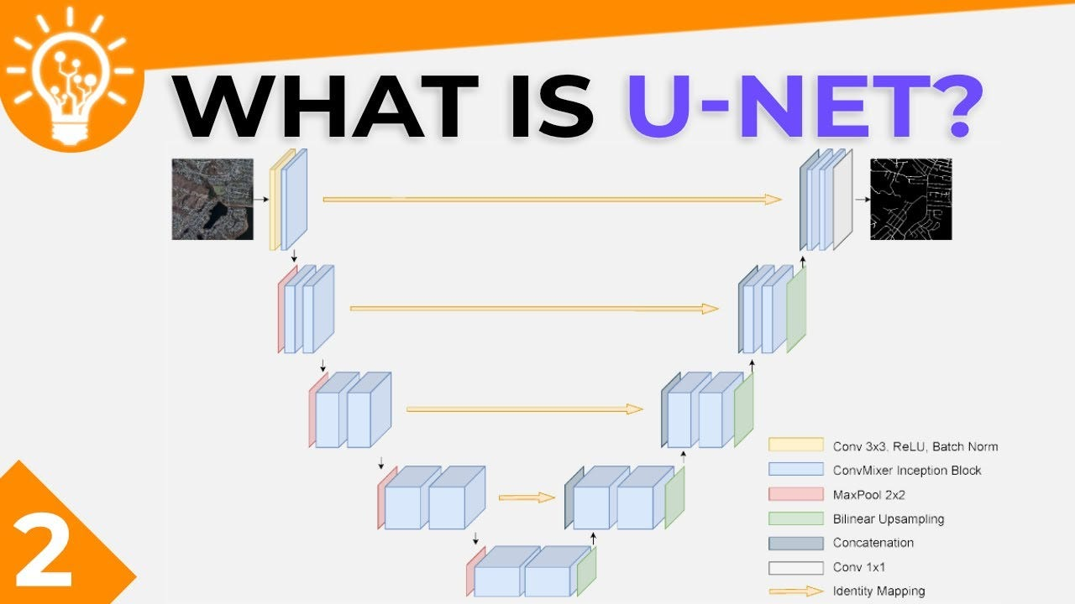
U-Net Architecture

Slide 15
U-Net Architecture Components
Encoder
Extracts features & reduces dimensions
Bottleneck
Deepest layer with abstract features
Decoder
Upsamples & reconstructs
Skip Connections
Preserves spatial information

Slide 16
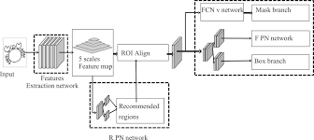
Mask R-CNN
Extends Faster R-CNN by adding a mask prediction branch for Instance Segmentation

Slide 17
Segmentation Applications
• Medical Imaging: Tumor segmentation, organ delineation
• Autonomous Driving: Road & lane detection
• Agriculture: Crop monitoring, disease detection
• Satellite Imagery: Land cover mapping

Slide 18
Vision Transformers
Transformers Meet Computer Vision

Slide 19
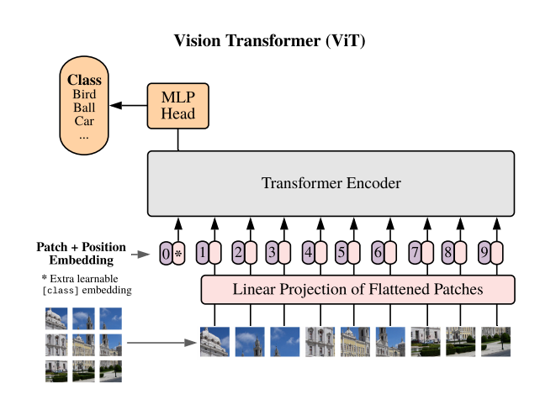
Vision Transformer (ViT)
An Image is Worth 16x16 Words: Transformers for Image Recognition at Scale Dosovitskiy et al., 2020

Slide 20
How Vision Transformers Work
1. Patch Embedding: Split image into patches
2. Linear Projection: Flatten & project patches
3. Position Encoding: Add positional info
4. Transformer Encoder: Self-attention layers
5. Classification Head: Final prediction

Slide 21
Vision Transformers vs CNNs
CNNs
ViT
• Locality bias
• Translation equivariance
• Efficient with small data
• Hierarchical features
• Global attention
• Less inductive bias
• Scales with data
• Long-range dependencies

Slide 22
When to Use Vision Transformers
Use ViT: Large datasets, transfer learning, global context important
Use CNNs: Limited data, real-time inference, edge deployment

Slide 23
Model Performance Comparison
YOLOv8
100+ FPS
High
Real-time detection
Faster R-CNN
5-7 FPS
Very High
High accuracy
U-Net
15-30 FPS
High
Medical segmentation
Mask R-CNN
5 FPS
Very High
Instance segmentation
ViT
30-50 FPS
Very High
Classification

Slide 24
Key Takeaways: Object Detection
• Object detection = Classification + Localization
• IoU and NMS are essential post-processing steps
• YOLO revolutionized real-time detection
• mAP is the standard evaluation metric
• Choose based on speed vs accuracy needs

Slide 25
Key Takeaways: Segmentation
• Segmentation provides pixel-level understanding
• Semantic vs Instance: pixels vs objects
• U-Net's skip connections preserve details
• Mask R-CNN extends detection to segmentation
• Critical for medical & autonomous driving

Slide 26
Key Takeaways: Vision Transformers
• ViT applies Transformers to images
• Image patches as sequence tokens
• Global attention from first layer
• Requires large datasets or pretraining
• State-of-the-art on many benchmarks

Slide 27
Resources & References
Key Papers:
• YOLO (Redmon et al., 2015)
• Faster R-CNN (Ren et al., 2015)
• U-Net (Ronneberger et al., 2015)
• Mask R-CNN (He et al., 2017)
• ViT (Dosovitskiy et al., 2020)

Slide 28
Hands-on Activities
YOLO demo
2. Segmentation practice
3. ViT exploration

Slide 29
Assignment
1. Refine your CV project
2. Explore detection/segmentation if applicable
3. Experiment with pretrained models
4. Document methodology
5. Prepare for MLOps session

Slide 30
Questions?
Let's discuss!

Slide 31
Thank You!
Keep Learning, Keep Building

